Slide 1
Group 3 - Final Project
Zonaira Hussain
Dylan Ritchings
Luke Foster
Thomas Glynn

Slide 2
Issues In the production
Unfortunately we were unable to fully deploy the pipeline
All pods are running successfully
Difficulties arose when attempting to communicate between said pods.

Slide 3
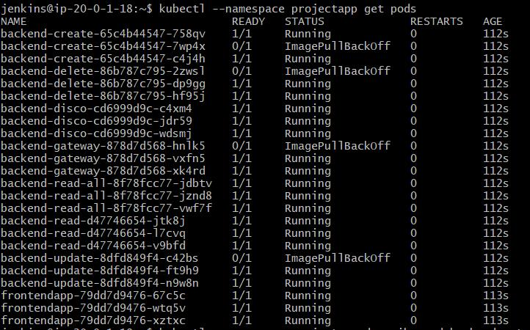
Dev-ops Issue
Issues arose when we found outDocker hub has a limit on the amount of pulls you can make (ImagePullBackOff)
Docker hub refreshes its limit every 6 hours
Even paying for Pro did not remove this issue
At the stage of pointing the nodes together but was unable to solve.

Slide 4
Management of the project
Scrum Master and Dev-Ops Manager: Zonaira
Front-end Manager: Luke
Back-end Manager: Dylan
Front-end assistant, and Documentation: Thomas
These were roles given but due to the nature of the project and size of the team we all helped each other out and got involved in each part.

Slide 5
The Brief
This was a Group Project to fully develop an application and deploy it.
We had 2 weeks to create the program, pipeline and all accompanying documentation
Development of a Spring Boot Help Queue with full CRUD functionality for practical use as a training aid in the Academy.
Expected to implement Basic Functionality and at least two additional features.
We Decided on incorporating: Solutions, Urgency, and Filtering.

Slide 6
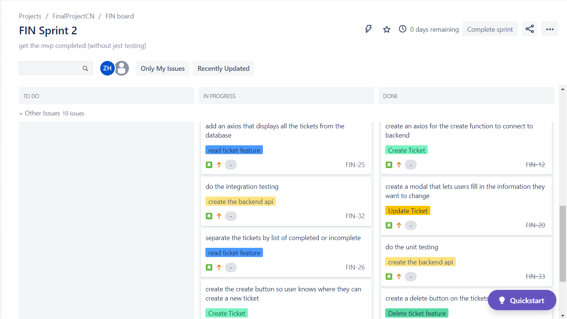
Jira Board
In progress sprint
With stories from separate epics
Link to Jira board within ReadMe

Slide 7
New tools Learned
React
Spring Micro services
Jest

Slide 8
Incorporation of new tools
We used React and Jest for the front-end
Spring Boot microservices for the back-end

Slide 9
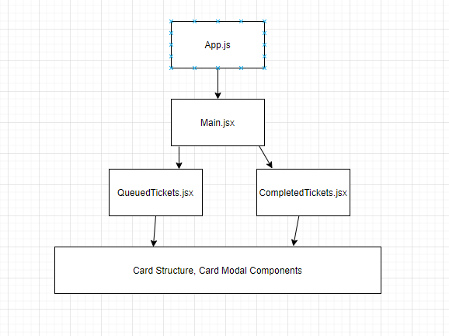
React
Open-source
Created and maintained by Facebook
Painless delivery of interactive UIs
Localised rendering of components
Render on the server using Node

Slide 10
Priorities for the Front-end
Functionality
Design simplicity
Intuitive operation

Slide 11
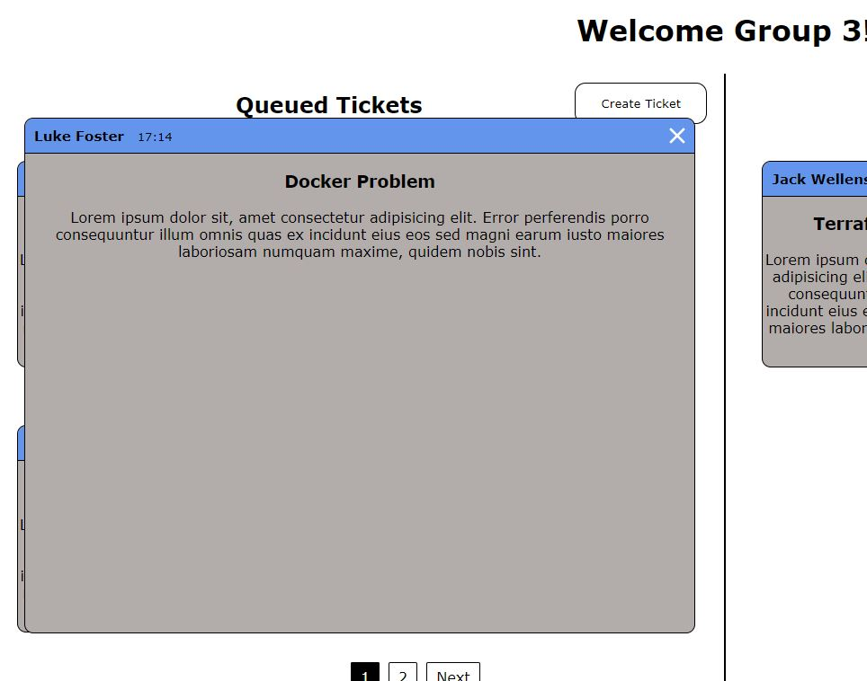
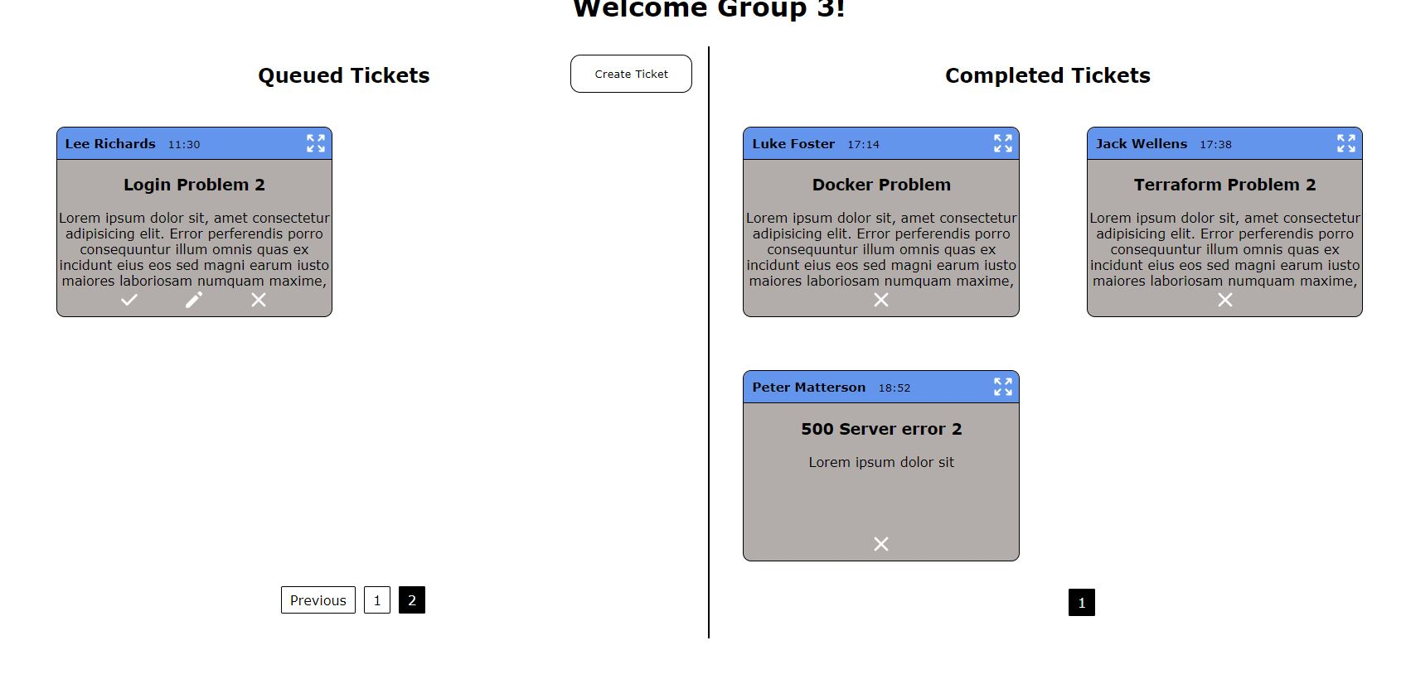
Design Evolution

Slide 12
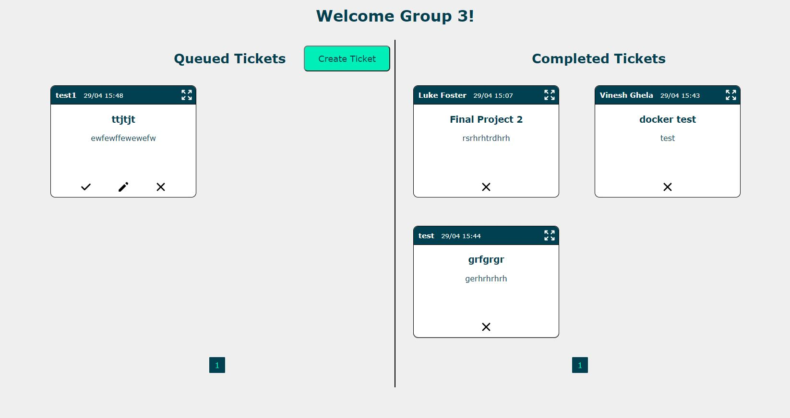
Our Landing Page
In keeping with QA’s Colour scheme
Simple and intuitive design
Clearly showing which tickets are queued and which are completed.

Slide 13
Jest
“A JavaScript Testing Framework with a focus on simplicity” – QA Community
Minimal Configuration
Snapshots
Isolated
Fast
Coverage
Easy Mocking

Slide 14
Spring Micro Services
Breaking a traditionally monolithic style spring boot program into separate modules
Advantages in large-scale architecture including:
scalability
fault isolation and resilience
Programming language flexibility
Improved data security
When updating one feature you only need to redeploy one service rather than the whole application.

Slide 15
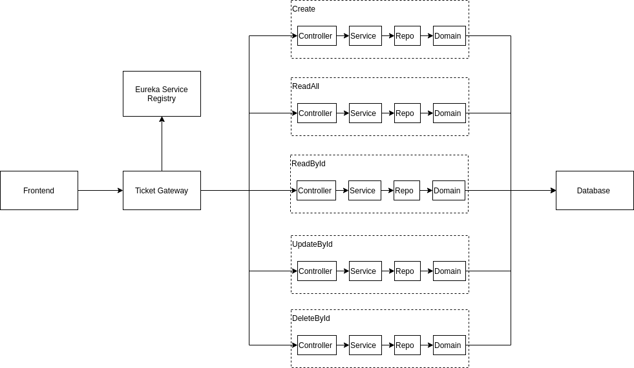
Microservice Structure
A separate service for each available fetch request
Full CRUD utilization
Eureka directs the fetch requests and load balances services

Slide 16
Priorities for Back-End
Utilising Microservices
Seamless CRUD functionality
High test coverage

Slide 17
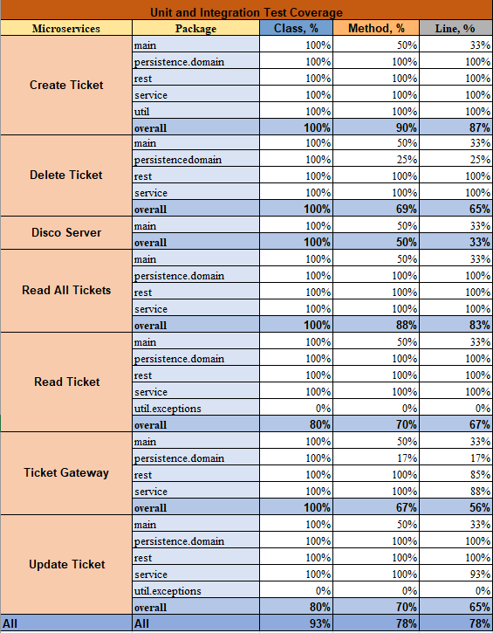
Spring Boot testing
High Test coverage
Each service needed to test every component

Slide 18
Dev-ops Breakdown
Terraform
Ansible
Kubernetes
Docker
NGINX
Jenkins

Slide 19
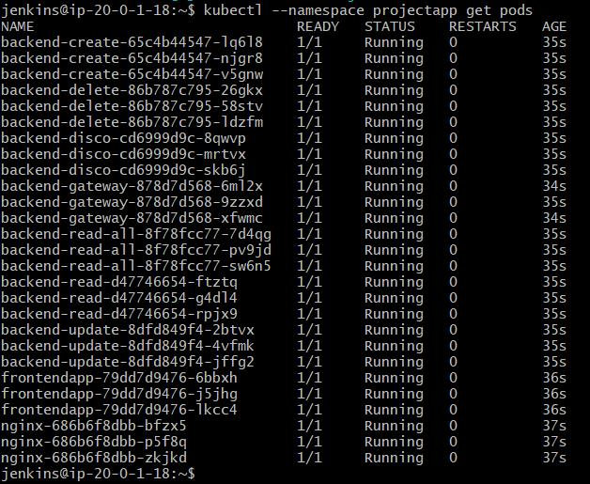
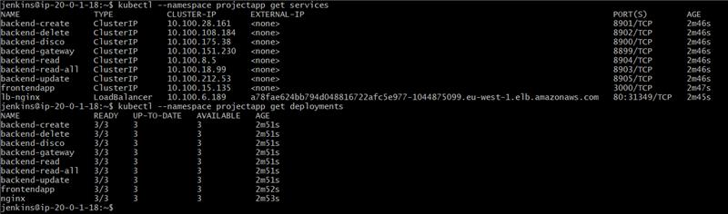

Slide 20

Demo

Slide 21
What we learnt
Separate pipelines is best practice when dealing with Microservices.
Docker hub has a limit on the amount of pulls you can make.
Microservice application are generally more complex than monolithic to deploy in the cloud.
Optimising the amount of re-renders (Very easy to get “Too many re-renders” error).

Slide 22
How to improve next time
Ticket gateway is single point of failure, fix: apply round robin load balancing.
For small scale applications, Monolithic style is more efficient and easier to deploy.
For larger applications microservices should be broken into sensible API’s in the planning stage(this project CRUD shouldn’t have been four microservices).

Slide 23

Q&A
Any questions for the team?

